Slide 1
Chapter One Elasticity

Slide 2
Elastic Properties of Materials
Stress
Strain
- Young’s Modulus

Slide 3
Stress and Strain
Stress is a quantity that is proportional to the force causing a deformation.
Stress is the external Force acting on an object per unit cross-sectional Area.
Strain is the result of stress ,which is the measure of the degree of deformation .

Slide 4
Types of stress
Tension
Stress
Compression
Stress
Shear
Stress

Slide 5
Types of Stress
Tension of Stress : is the force per unit area producing elongation of an object.
F
F
Tension

Slide 6
Compression of Stress : is the force per unit area producing compression of an object.
F
F
Compression

Slide 7
Shear of Stress : is the opposite “sliding force “ applied to parallel force of the object . Producing change in shape of material without changing its volume
F
F
Shear

Slide 8
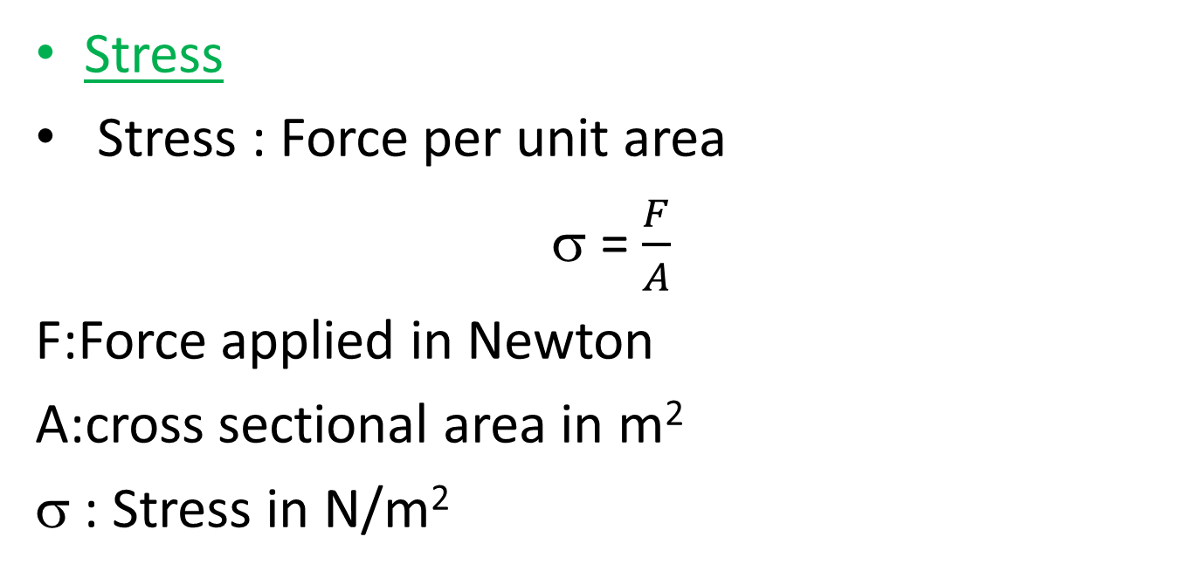
Stress
Stress : Force per unit area
= $\frac{F}{A}$
F:Force applied in Newton
A:cross sectional area in m²
σ : Stress in N/m²
A
F

Slide 9
Strain :Ratio of elongation of material to the original length
ε =$\frac{Δl}{l_{o}}$, where : Δl : elongation(m),l_{o} : original length of a material (m) and ε is strain ,Dimensionless.
Elongation Δl =l_{f} – l_{o}
Where : l_{f} loaded length of a material(m)
l_{o}
l_{f}

Slide 10
Relation between Stress and Strain
The relation between the stress and the strain for a material under tension can be found experimentally .
A plot of stress vs. strain .
The diagram gives us the behavior of the material and material properties

Slide 11
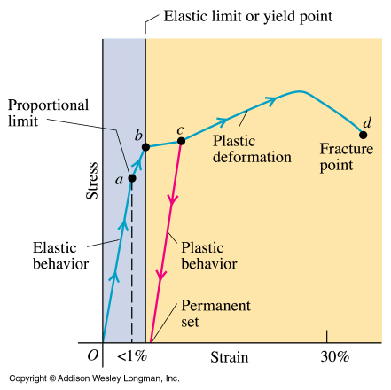

Slide 12
Elastic Limit
For small values of the strain , the stress – strain graph is a straight line ; the stress σ is linearly proportional to the strain ε .Beyond the linear limit A ,the stress is no longer linearly proportional to the strain .However ,from A to the elastic limit or yield point B ,the object still returns to its original dimensions when the applied force F is removed .

Slide 13
The deformation up to B is said to be elastic
If the applied force is further increased ,the strain increased rapidly . In this region ,if the applied force is removed ,the object does not return completely to its original dimensions; it retains a permanent deformation .The highest point C on the stress-strain graph is the ultimate tension strength σ1 of the material or its maximum stress .Beyond this point ,additional strain is produced even by a reduced applied force , and fracture occurs at point D .From B to D the material is said to undergo plastic deformation .If the ultimate tension strength and fracture points C and D are close together , the material is brittle ; if they are far apart the material is said to be ductile

Slide 14
Young’s modulus of elasticity is a value that measures a materials resistance to being deformed elastically .
Hardness is a measure of how resistant solid matter is to various kinds of permanent shape change when a compressive force is applied .

Slide 15
Young’s Modulus and Hook’s Law
In the linear region of the strain vs. stress diagram , the slope equals the stress-strain ratio and is called Young’s Modulus or Elastic Modulus (E) of the material .

Slide 16
Breaking point
Elastic limit
Stress(MN/m2)
Elastic behavior
strain

Slide 17
Elastic Modulus =$\frac{ stress}{strain}$
Y = $\frac{σ}{ε}$
Example:
A 10⁸N/m² stress produces a strain 5x10⁻⁴.What is Young’s modulus for this bar?
Solution :
Y =$\frac{σ}{ε}$ = $\frac{{10}^{8}}{5x10−4}$ = 20x10¹⁰ N/m²

Slide 18
Deformation types and define an elastic modulus
1.Young’s modulus ,which measures the resistance of a solid to a change in its length.
نتوقع معامل يونح للحديد اكبر من معامل يونج للمطاط
2. Shear modulus ,which measures the resistance to motion of the planes within a solid parallel to each other.
3. Bulk modulus , which measures the resistance of solider or liquids to changes in their volume.

Slide 19
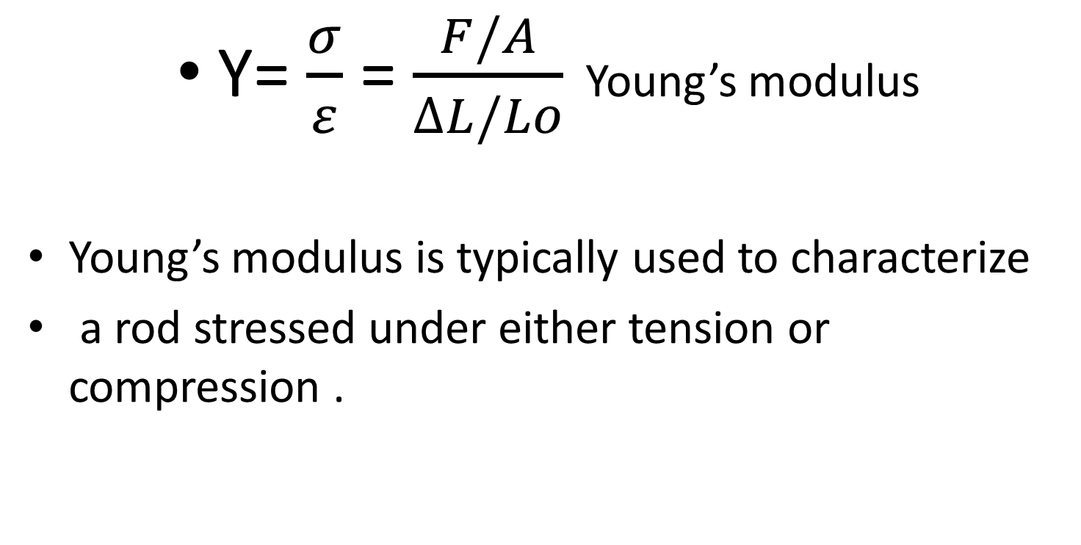
Young’s Modulus : Elasticity in Length
Y= $\frac{σ}{ε}$ = $\frac{F/A}{∆L/Lo}$ Young’s modulus
Young’s modulus is typically used to characterize
a rod stressed under either tension or compression .

Slide 20
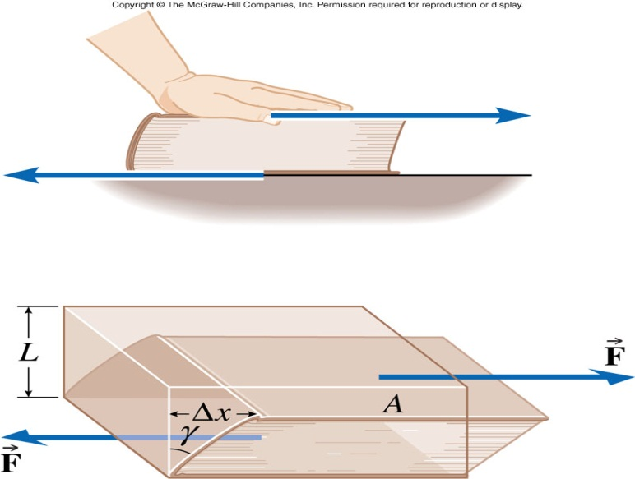

Shear Modulus :Elasticity of Shape
Y = $\frac{σ}{ε}$=$\frac{F/A}{∆x/h}$ Shear modulus
Where $∆x is the horizontal distance that the sheard$
$face moves and h is the height of the object$
$$∆x$$
F
h
-F
Fixed face

Slide 21
Bulk Modulus : Volume Elasticity
Y = $\frac{σ}{ε}$ = $\frac{∆F/A}{∆V/V_{i}}$ = - $\frac{∆P}{∆V/V_{i}}$ Bulk modulus
-A negative sign is inserted in this defining equation so that Y is a positive number . This maneuver necessary because an increase in pressure ( positive ΔP) cause a decrease in volume ( negative ΔV) and vice versa.
Vi
F
Vi+ΔV

Slide 22
Typical Values for Elastic Moduli
substance | Young’s Modulus (N/m²) | Shear Modulus (N/m²) | Bulk Modulus (N/m²)
Tungsten | 35x10¹⁰ | 14x10¹⁰ | 20x10¹⁰
Steel | 20x10¹⁰ | 8.4x10¹⁰ | 6x10¹⁰
Copper | 11x10¹⁰ | 4.2x10¹⁰ | 14x10¹⁰
Brass | 9.1x10¹⁰ | 3.5x10¹⁰ | 6.1x10¹⁰
Aluminum | 7.0x10¹⁰ | 2.5x10¹⁰ | 7.0x10¹⁰
Glass | 6.5-7.8x10¹⁰ | 2.6-3.2x10¹⁰ | 5.0-5.5x10¹⁰
Quartz | 5.6x10¹⁰ | 2.6x10¹⁰ | 2.7x10¹⁰
Water | --------- | ------- | 0.21x10¹⁰
Mercury | --------- | ------- | 2.8x10¹⁰

Slide 23
Example :
How much pressure is needed to compress the volume of an iron block by 0.10 percent ? Express answer in N/m² , and compare it to atmospheric pressure (1.0x10⁵ N/m²) ?
Yong’s modulus for iron (90x10¹⁰ N/m² )
Solution :
Y = - $\frac{∆P}{∆V/V_{i}}$
$\frac{∆V}{∆V/V_{i}}$ = $\frac{0.1}{100} = 10−3$
Then : 90x10¹⁰ = - $\frac{∆P}{{10}^{−3}}$
ΔP= 90x10⁶ N/m²

Slide 24
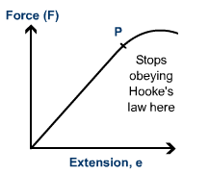
Hook’s Law
The linear stress – strain region in the diagram is called Hook’s Law region .In this region ,since the stress is linearly related to the strain . The force is linearly related to the elongation .

Slide 25
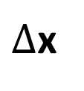
F = - k x
Where”
K is force constant.
Y = $\frac{σ}{ε}$
$σ=Y ε$
ε =$\frac{Δl}{l_{o}}$ and $σ= \frac{F}{A}$
Then :
$\frac{F}{A}$ = Y $\frac{Δl}{l_{o}}$
Thus , in tension or compression
the force on an object is proportional
to its elongation
Original x=0
$∆$x
New x=0

Slide 26
Then :
$k=\frac{yA}{l_{o}}$
F = k $∆l Hook^{′}s Law$
Where k is the spring constant ,
ينطبق قانون هوك على المواد في المنطقة التغير الخطي بين الاجهادstress والانفعال strain.
وتكون قيمتة (K)كبيرة بزيادة مساحة المقطع بينما تقل بزيادة الطول

Slide 27
Example:
A solid brass sphere is initially surrounded by air , and the air pressure exerted on it is 1x10⁵N/m² (normal atmospheric pressure ).
The sphere is lowered into the ocean to a depth where the pressure is 2x10⁷N/m² .The volume of the sphere in air is 0.5m³ .By how much does this volume change once the sphere is submerged ?

Slide 28
Example :
A vertical steel girder with a cross-sectional area of 0.15m² has a 1550 kg sign hanging from its end (Ignore the mass of the girder itself .)
( a ) what is the stress within the girder?
( b ) What is the strain on the girder ?
( c ) If the girder is 9.50 m long , how much is it lengthened ?

Slide 29
Example :
A 15 cm long tendon was found to stretch 3.7 mm by a force of 13.4 N . The tendon was approximately round with an average diameter of 8.5 mm .Calculate the elastic modulus of this tendon .

Slide 30
Example :
A nylon tennis string on a racquet is under a tension of 250N . If its diameter is 1.00 mm , by how much is it lengthened from its un – tensioned length ?

Slide 31
Example
A bar has dimensions 1 cm by 1cm by 20cm .It is subjected to a 10000N tension force and stretches 0.01cm . Find :
( a ) the stress;
( b ) the strain;
( c ) If the stress-strain graph is straight line ,how much does the bar stretch when the applied force is increased to 50000N?

Slide 32
Poisson’s ratio Shear stress – strain diagram
L
P
d
d’
L’
P

Slide 33
Definition
When a deformable body is stretched by a tensile force ,not only it does elongate but it also contract laterally . i.e. it would contract in other two dimensions.
Likewise , a compressive force acting on a deformable body cause it to contract in the direction of force and yet its sides expand laterally .
When the load P is applied to the bar it changes the bar’s length by δ and its radius by δr .The strain in axial direction and in lateral / radial direction are respectively .

Slide 34
In early 1800s, French scientist Poisson realized that within elastic range the ratio of these two strains is a constant . We called the constant as Poisson’s ratio by

Slide 35
ε_{long} = $\frac{L^{′}−L}{L}$
ε_{lat} = $\frac{d^{′}−d}{d}$
Then the Poisson’s ratio define as :
Poisson’s ratio == - $\frac{Lateral strain}{longitudnal strain}$
ν = - $\frac{ε_{lat}}{ε_{long}}$
In tension the ε_{long} is ( + ) and ε_{lat} is ( - )
But in compression state the ε_{long} is ( - ) and ε_{lat} is ( + )
The value of 0$≤ ≤0.5$

Slide 36
Poisson’s ratio for important material
Material | Poisson’s Ratio
Cork | 0.5
Rubber | 0.48 to 0.5
Lead | 0.44
Copper | 0.37
Aluminum | 0.35
Stainless Steel | 0.3
Steel | 0.29

Slide 37
Remarks:
The lateral strain is caused only by axial force .No force or stress acts in lateral direction ,
Lateral strain is the same in all lateral direction
Usually 0$≤≤0.5;for most linearly$
elastic material ν=0.3.
.Poisson’s ratio is a constant

Slide 38
Question :
For a 10 m rod made of the material with Poisson’s ratio ν=0.3,that has elongated by 12mm ,what is its new radius if originally it had a radius of 50mm?
(a)50.018mm (b)49.982mm (c ) 50.400mm (d)49.600mm

Slide 39
Shear Stress-strain relation
Ultimate stress
Fallure stress
Proportional
limit
Modulus of rigidity , G
(or shear modulus of elasticity
τ=Gγ
σ=Eε
Stress(τ)
Strain(γ)

Slide 40
Material property relations
G=E/(2(1+ν))
Where: E is Young’s modulus
G is modulus of rigidity
ν is Poisson’s ratio

Slide 41
Example:
A cubic block with each side of original length 4 in . Is subjected to the compressive force as shown . If its sides along the x and y direction increased to 4.0001 in , determine ν and G for the material .Assume it behaves elastically and E=10x10³ ksi
10 kip
4in

